Slide 1
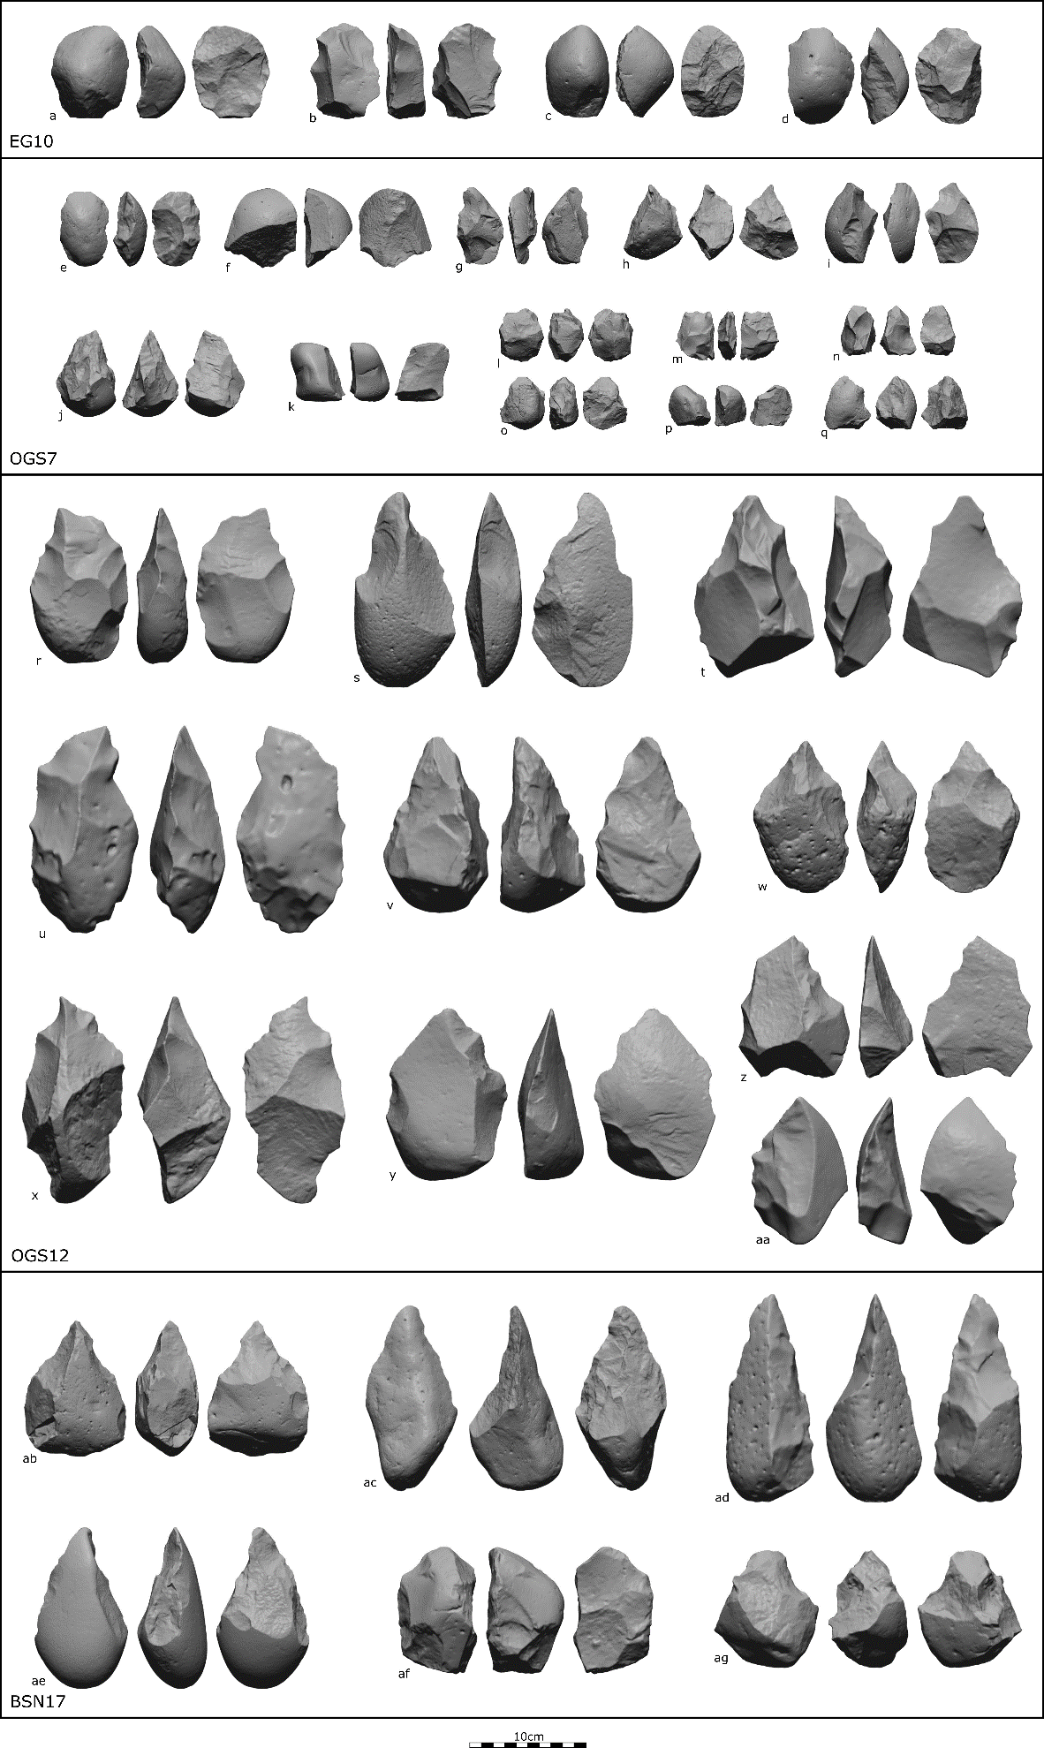
Notes:
Figure 1: 3D Artifact scans from Gona used in this study

Slide 2
[Possible Figure 2: Site map?]

Slide 3
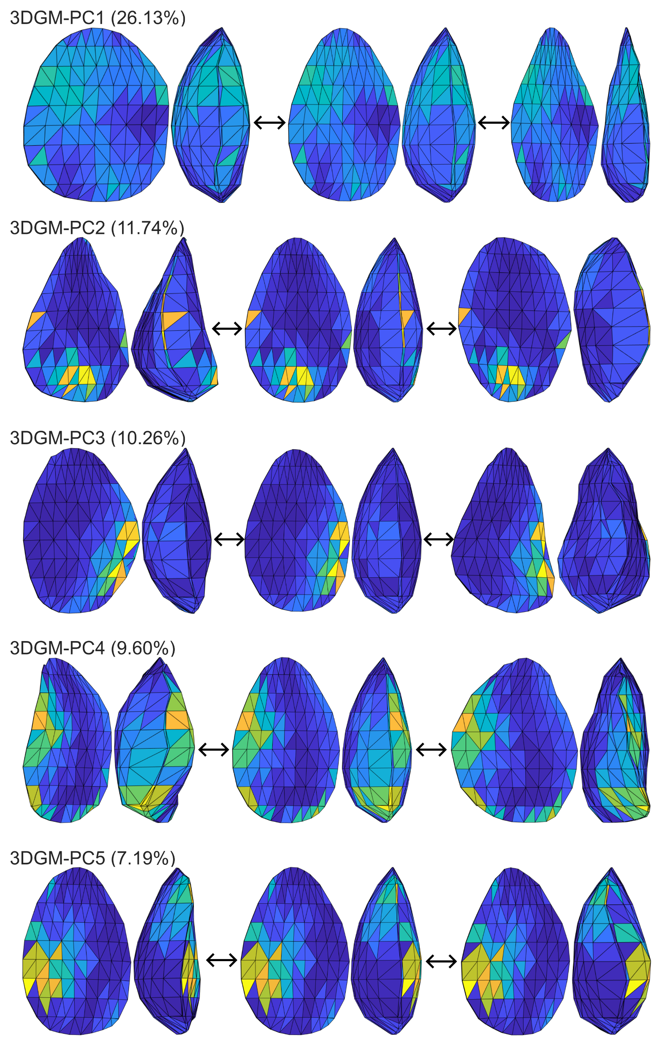
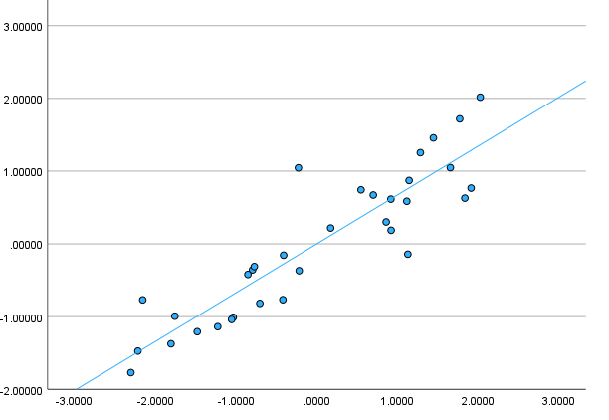
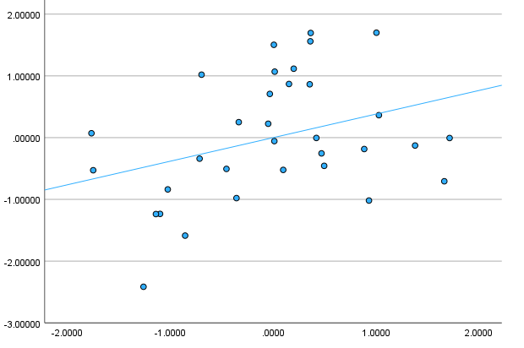
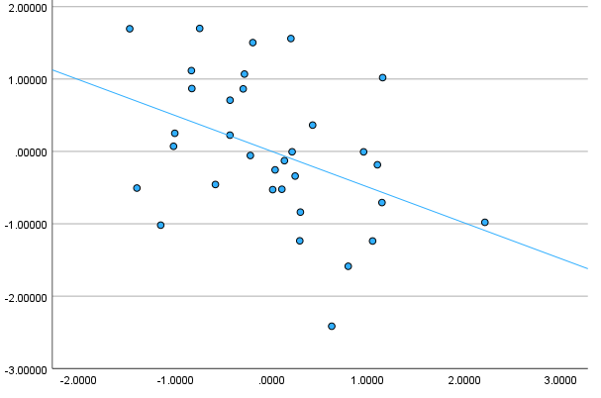
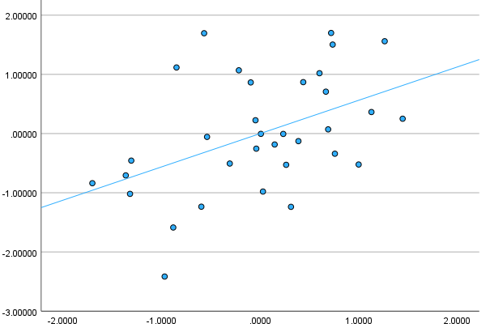
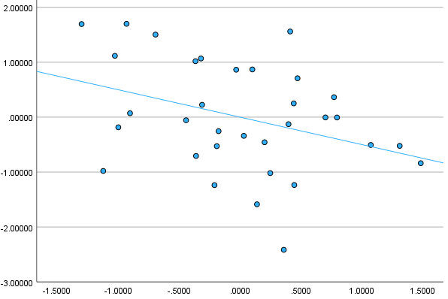
(a)
(b)
Linear-PC1
3DGM-PC1
(c)
Linear-PC2
3DGM-PC2
3DGM-PC3
3DGM-PC4
3DGM-PC5
Notes:
Figure 3: (a) Illustration of variation captured by 3DGM-PCs, and plots of correlation between (b) Linear-PC1 and 3DGM-PC1 artifact scores and (c) Linear-PC2 and higher order 3DGM-PCs

Slide 4
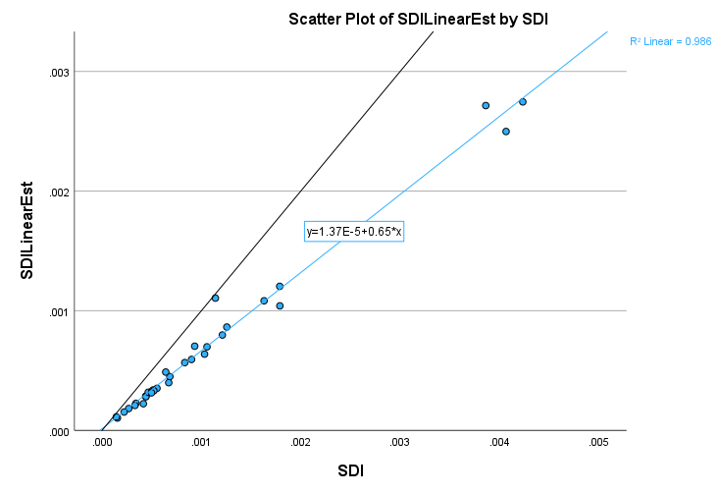
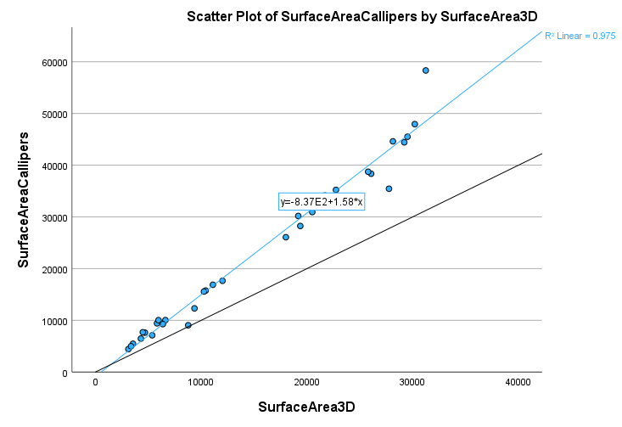
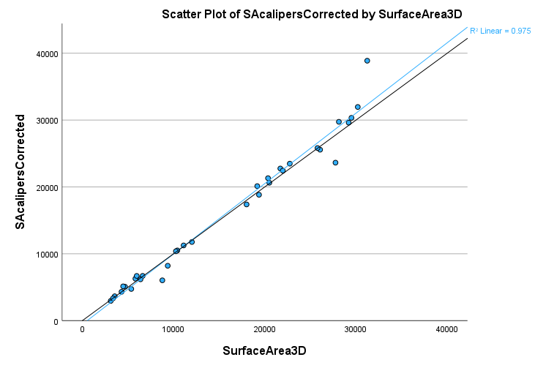
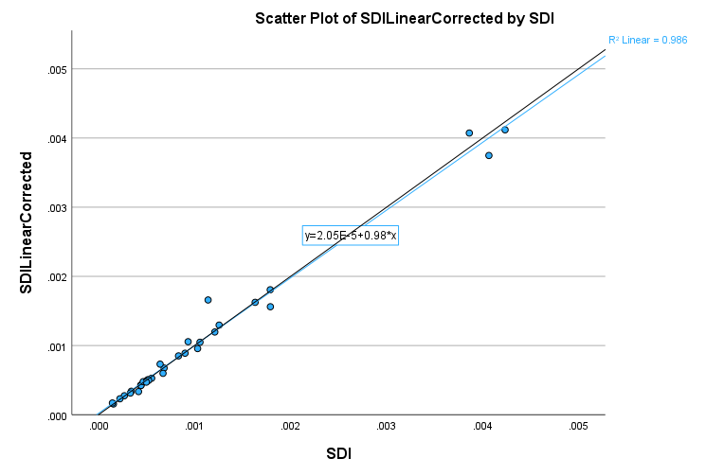
x=y
Raw
x=y
Corrected
Notes:
Figure 4: Surface area and SDI computed by caliper measures vs. 3D

Slide 5
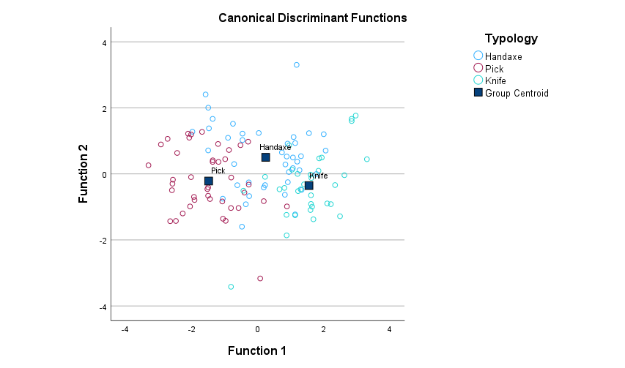
Notes:
Figure 5: Testing the validity of Acheulean typology

Slide 6
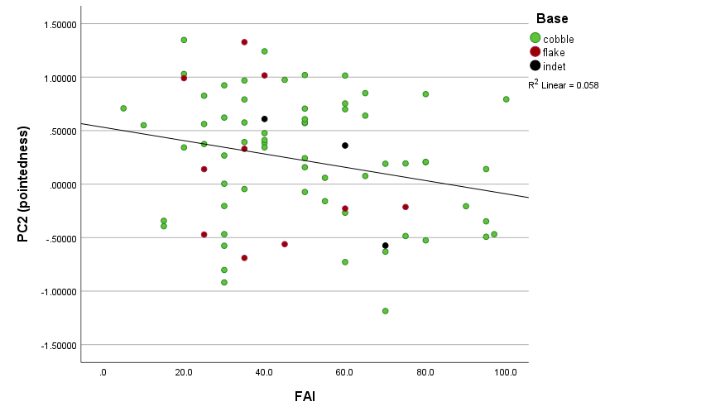
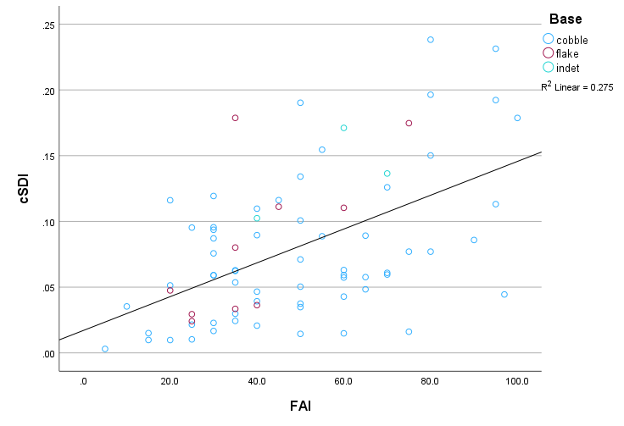
(a)
(b)
Notes:
Figure 6: Effect of FAI in pointedness (a) and relationship between FAI and cSDI (b)

Slide 7
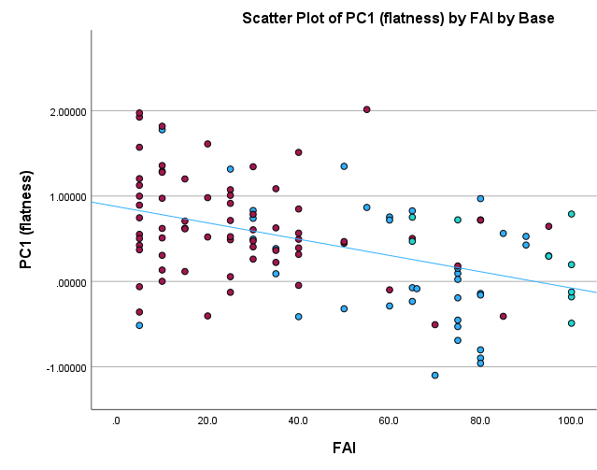
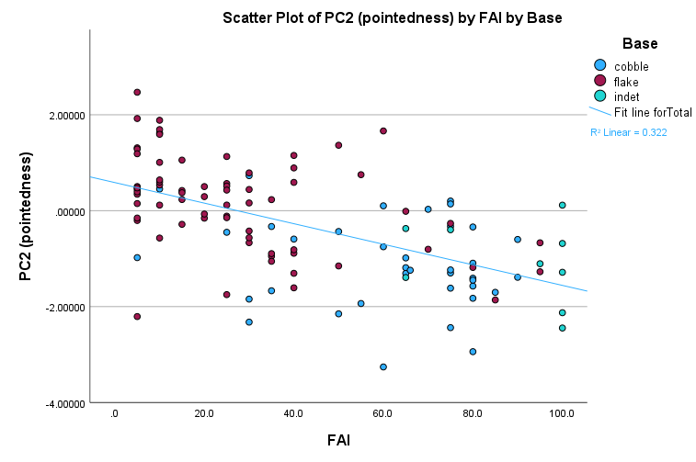

Slide 8
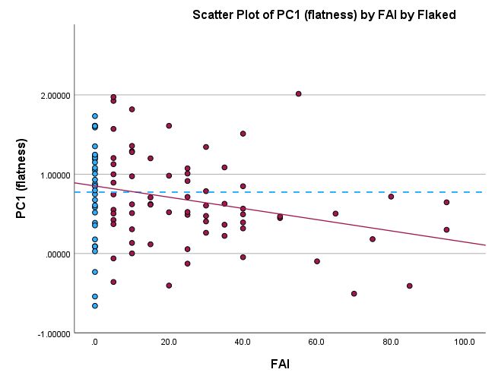
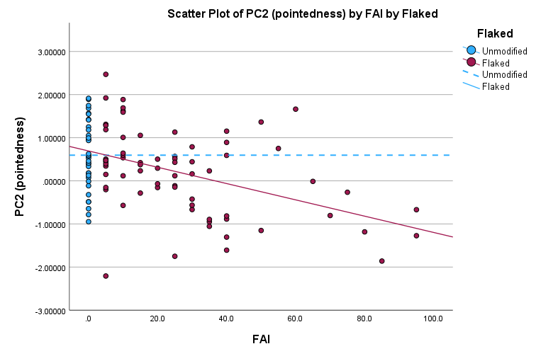
Notes:
Figure 9: Effect of FAI compared to unmodified large flakes from Acheulean contexts.

Slide 9
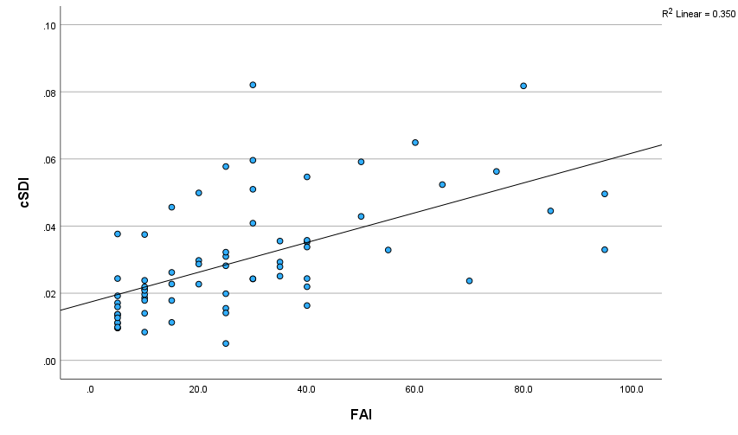
Mode 2 Flake Bases

Slide 10
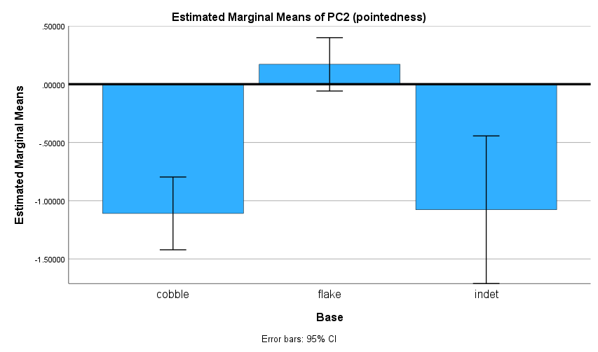
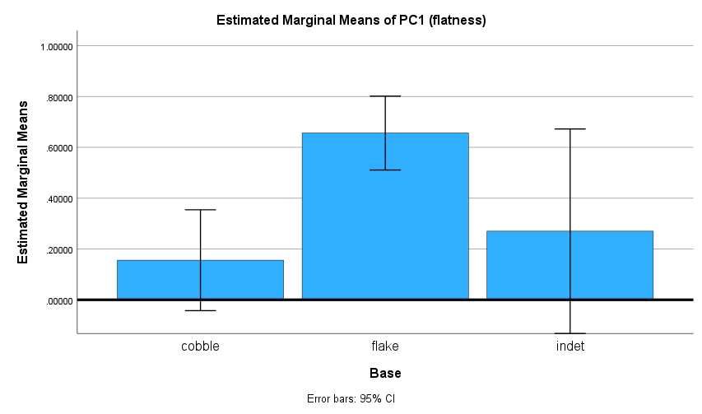
Indeterminate-base Mode 2 Cores
**
**
**
**
Notes:
Figure 10

Slide 11
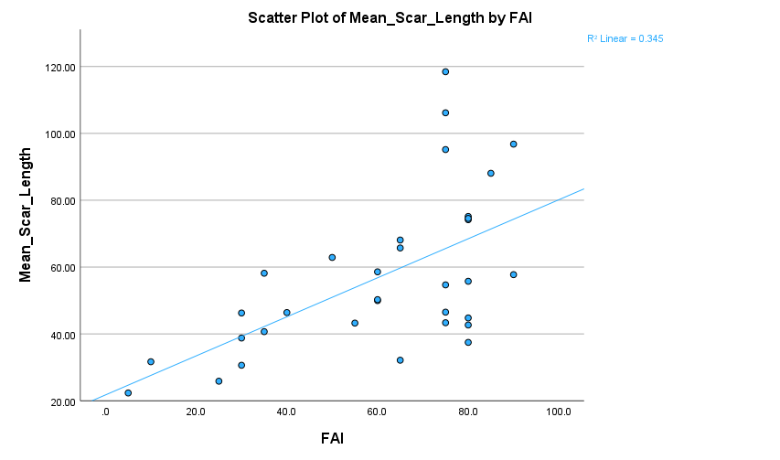
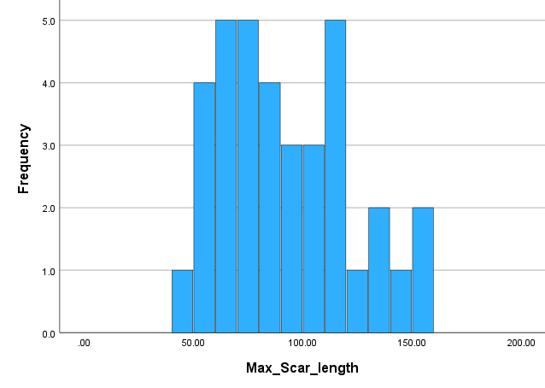
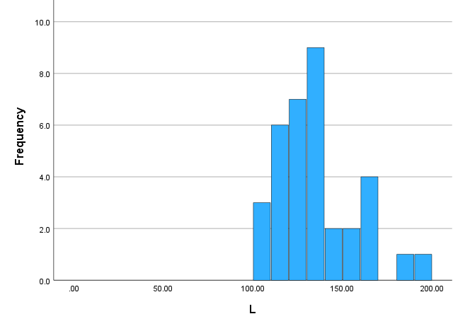
Largest Scars on Cobble cores
Length of Large Flakes

